Slide 1
Before we begin!!!!!
Political: Who controls what? What type of government is there? Anything to do with laws or war.
Economic: What type of economy? How do people make a living?
Geography: Where is it? Is the land mountainous? Desert? Oceanic?
Social: Religious, intellectual, artistic

Slide 2
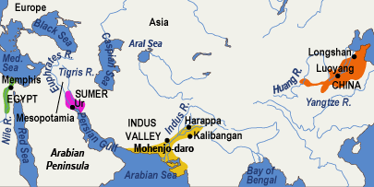
Ancient River Valley Civs

Slide 3
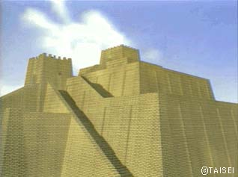
ANCIENT MESOPOTAMIA
Oldest known civilization
Cradle of Human Civilization
Old Testament
Nebuchadnezzar
Ziggurat (right)
Hanging gardens

Slide 4
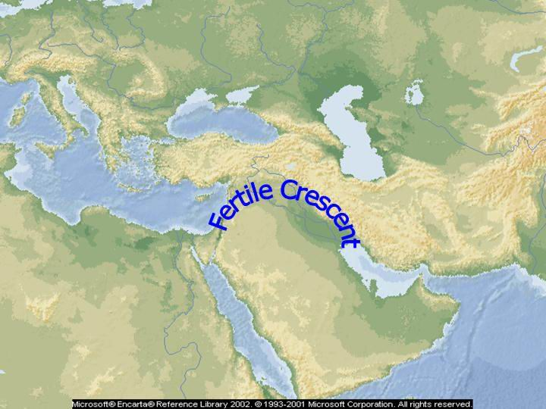
Geography
This civ rose in the valleys between the Tigris and Euphrates rivers.
Some say this Fertile Crescent was the real Garden of Eden.

Slide 5
In what modern day country was the Fertile Crescent?

Slide 6
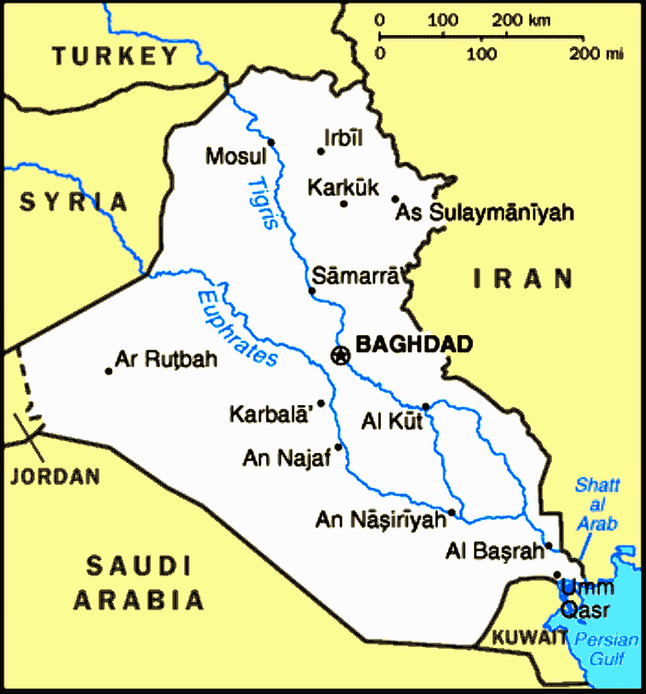

Slide 7
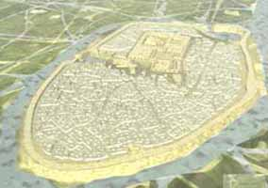
Ur, the capital city of Mesopotamia

Slide 8
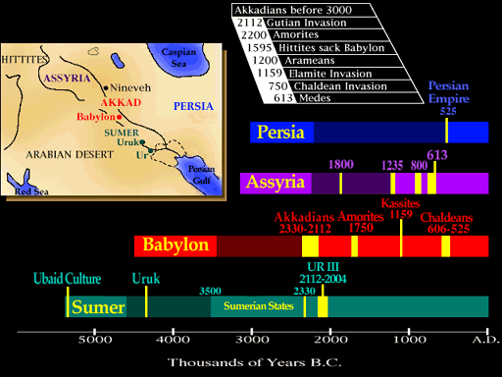
Political:What was the earliest kingdom in Mesopotamia? The second?

Slide 9
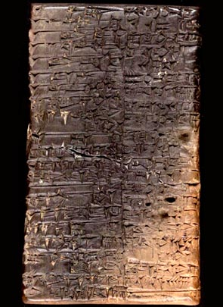
Social
This is cuneiform.
Babylonians wrote using this “wedge-shaped” writing on clay tablets.
The Sumerians invented writing.

Slide 10
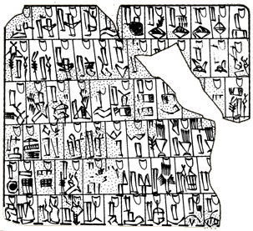
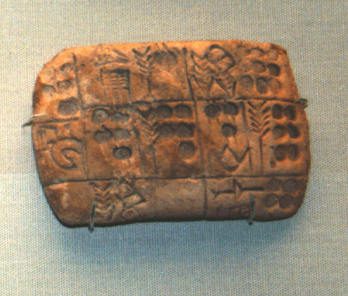
More cuneiform writing

Slide 11
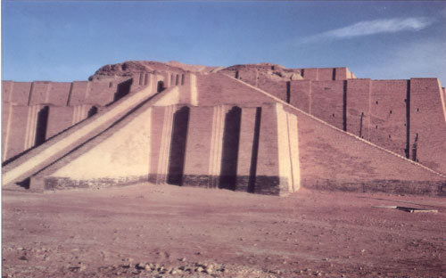
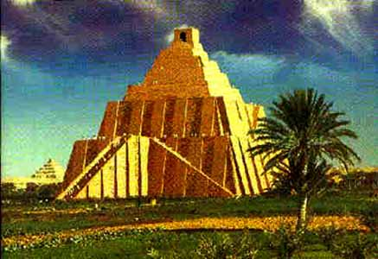
More ziggurats

Slide 12
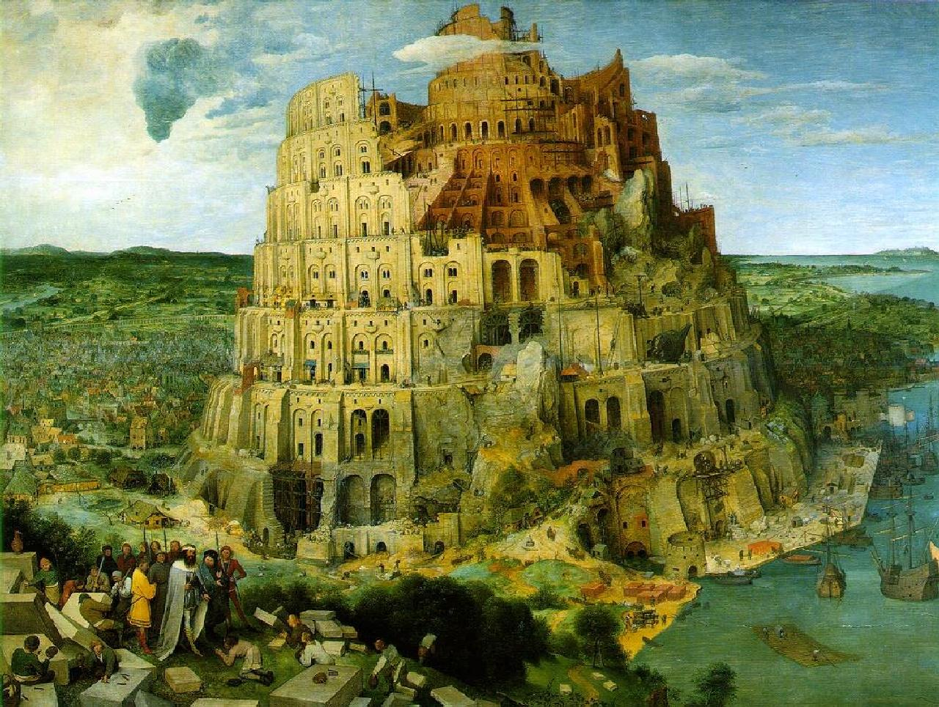

Slide 13
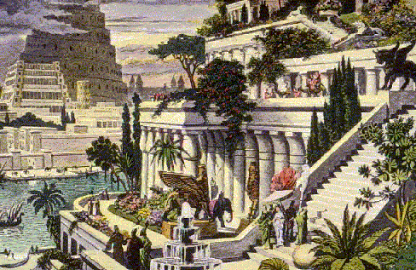
Hanging gardens of Babylonia

Slide 14
The ancient city of Babylon, under King Nebuchadnezzar II, must have been a wonder to the traveler's eyes. "In addition to its size," wrote Herodotus, a historian in 450 BC, "Babylon surpasses in splendor any city in the known world."
Herodotus claimed the outer walls were 56 miles in length, 80 feet thick and 320 feet high. Wide enough, he said, to allow a four-horse chariot to turn. The inner walls were "not so thick as the first, but hardly less strong." Inside the walls were fortresses and temples containing immense statues of solid gold. Rising above the city was the famous Tower of Babel, a temple to the god Marduk, that seemed to reach to the heavens

Slide 15
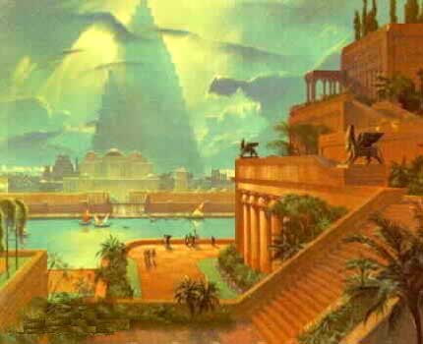
Another painting of the hanging gardens with Tower of Babel in back

Slide 16
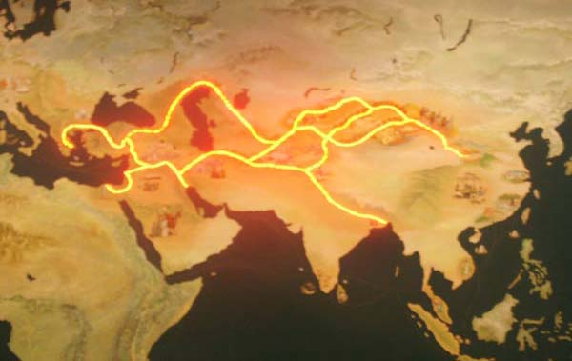
Economic: trade and farming
Sumerians (Mesopotamians) were known to trade with the Egyptians and the Indus Valley civilizations.
In later years, these trade routes became Silk Road.

Slide 17
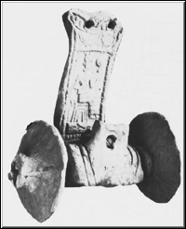
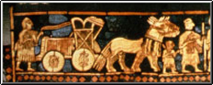
Sumerians invented the wheel!
The wheel was invented by 6000 BC!
It helped military, farming and trade.
At right, this is made of wood.

Slide 18
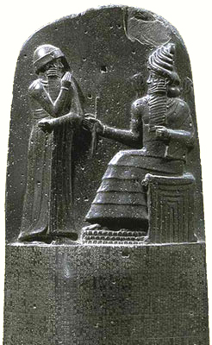
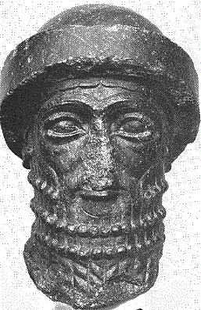
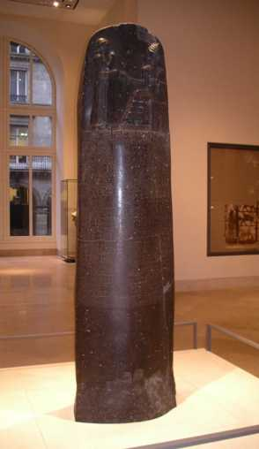
Political:Mesopotamian Law
Code of Hammurabi
“eye for an eye tooth for a tooth”

Slide 19
That concludes Mesopotamia.
Any questions before the quiz?

Slide 20
Mesopotamia Quiz
Political:What law system did Sumerians use? Hint: It can be summed: eye for eye; tooth for tooth.
Economic: How did Mesopotamians earn a living?
Geography:Between what 2 rivers did the Fertile Crescent appear?
Social:What type of writing did they use?

Slide 21
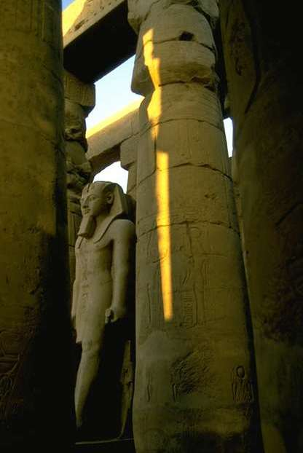
ANCIENT EGYPT
Nile River
Mummies
Pharaohs
Rameses
King Tutankhamen
Hieroglyphics

Slide 22
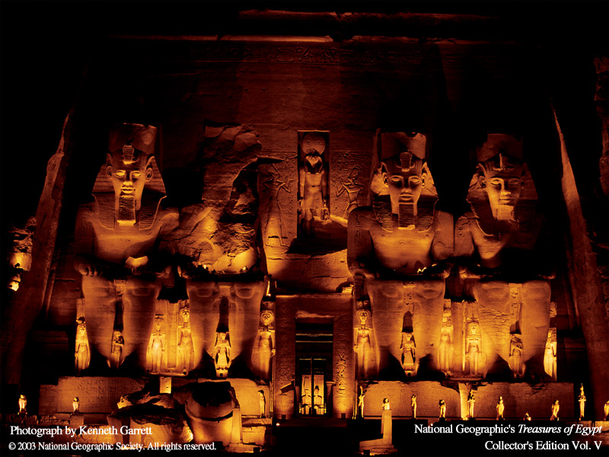
Egyptian civilization
Egyptian civilization arose a bit after Mesopotamia.
Geography: It was centered around the Nile River.

Slide 23
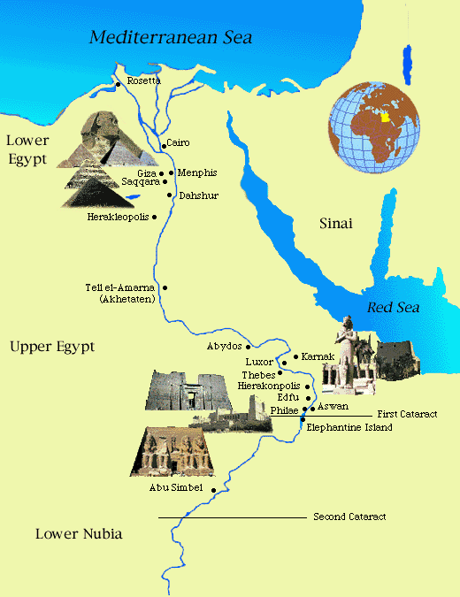
The Nile River

Slide 24
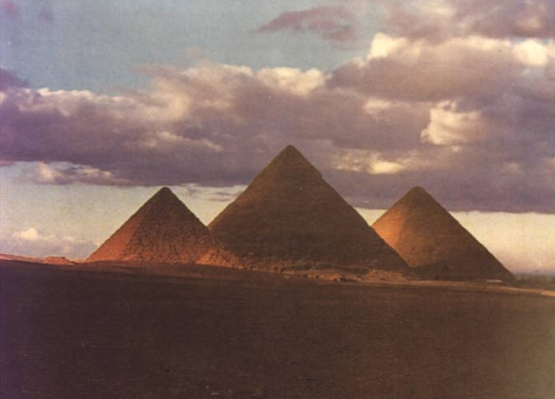
Pyramids
These are the Giza pyramids, the most famous.
Pyramids were tombs for the kings.
These were built in 3500 B.C.E.
How old are they?

Slide 25
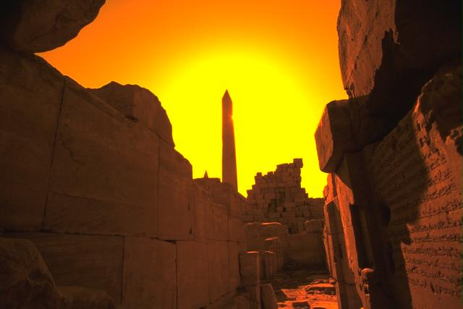

Slide 26
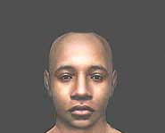
Political:Egyptian Pharaohs
Egyptians were led by Pharaohs.
They were priest-kings
King Tut is the most famous
Using computers, this image was reconstructed using his remains

Slide 27
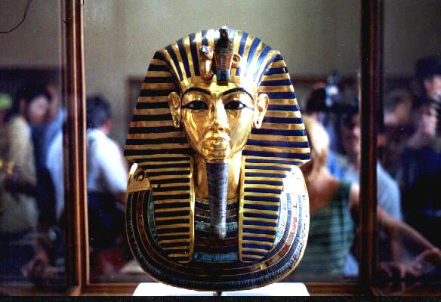
Tutankhamun

Slide 28
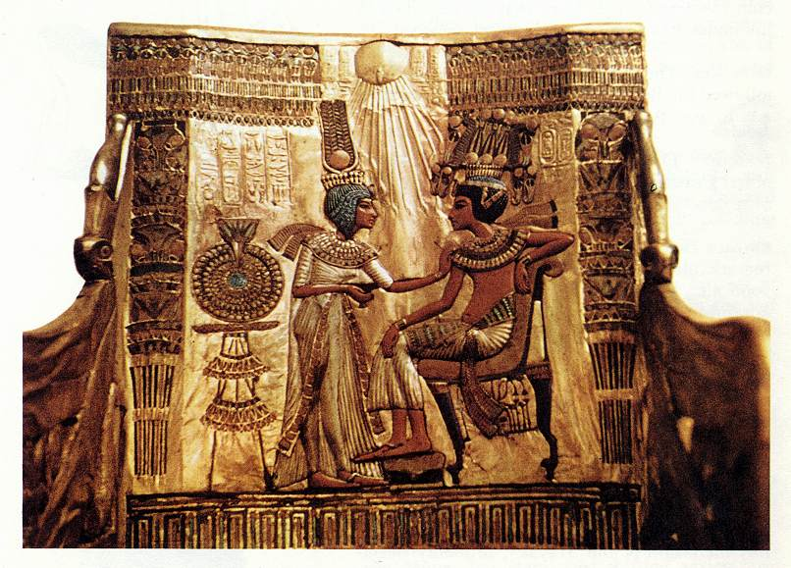
Tutankhamun on the throne

Slide 29
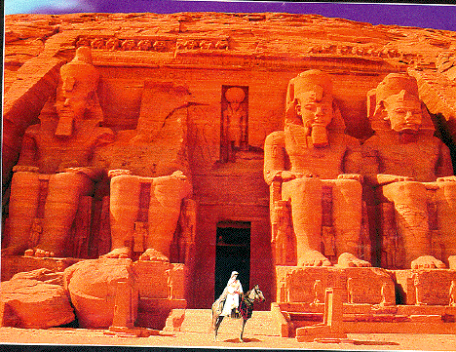
Abu Simbel was built by Ramseses II

Slide 30
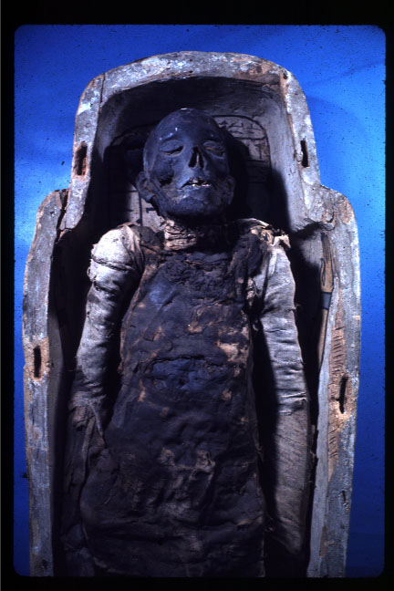
Mummies
Egyptians who could afford to do so would have themselves mummified.
They believed in a better afterlife if their body was preserved.

Slide 31
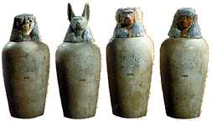
The Egyptians took out all of the internal organs, except the heart. When they removed them the organs were put in canopic jars, that were put in the tomb with the mummy. They did not take out the heart because it was believed to be the intelligence and emotion of the person. The Egyptians
thought the brain had no significant value, so they took it out through the nose. The body was packed and covered with natron (a salty drying agent). After this the body was left
for 40-50 days.

Slide 32
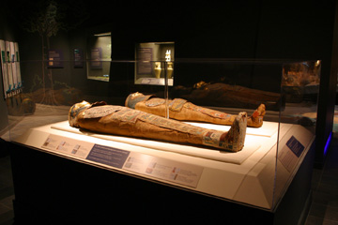
Mummies

Slide 33
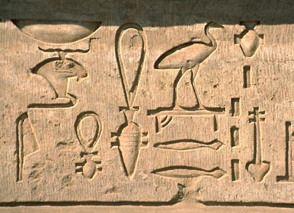
Egyptians wrote in hieroglyphics

Slide 34
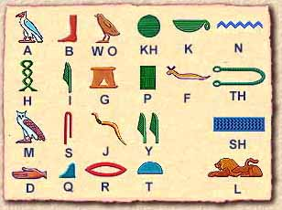
Hieroglyphics

Slide 35
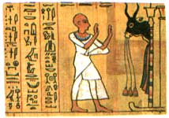
What did Egyptians write on?
Ancient Egyptians used papyrus, a substance derived from the plant of the same name

Slide 36
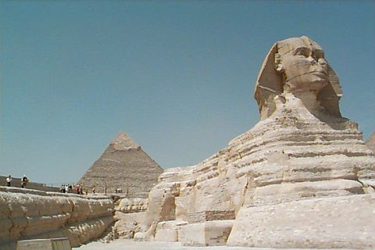
The Great Sphinx is located on the Giza plateau, about six miles west of Cairo.

Slide 37
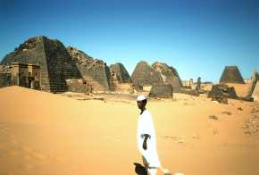
Nubia
People around the world have learnt about the glorious past of the Egyptian empire, but most have failed to learn of the Nubia, which was sometimes even stronger than the Egyptian empire. Nubia rivaled Egypt in wealth and power, and mutually influenced each other.

Slide 38
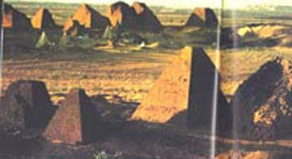
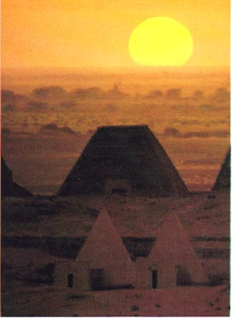
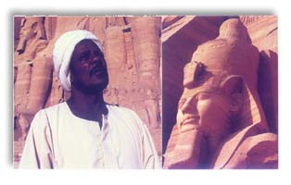
The Egyptians called them the Kush. The Kush was comparable with Egypt, and both states communicated with each other constantly. Today we do not hear of Nubia nor Kush. In its place is nothern Sudan. With the construction of the Aswan high dam in the 1960s, Nubian land was flooded and that forced some 100,000 Nubians to seek new homes in Egyptian and Sudanese cities. Nubia's glorious past is now under water.

Slide 39
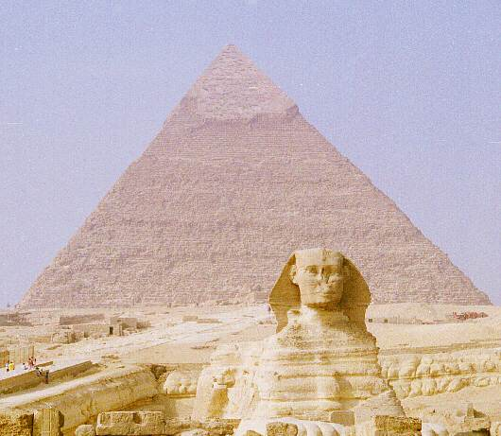
The Great Sphinx & Cheferen

Slide 40

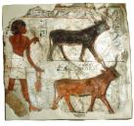

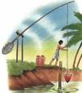

Egyptian economy
Although Egypt looks really sophisticated, the economy is a traditional economy based on farming and trade.
Egyptians traded up and down the Nile, with Mesopotamians and sometimes with Indus Valley (in Pakistan)

Slide 41
That concludes Egypt.
Any questions before the quiz?

Slide 42
Egypt Quiz
1.What river is the basis for Egyptian civilization?
2.What “paper” did Egyptians write on?
3. What is an Egyptian ruler called?
4.What writing system did Egyptians use?
5.What other African kingdom did Egypt trade and interact with?
6. What type of economic system did Egypt have?

Slide 43
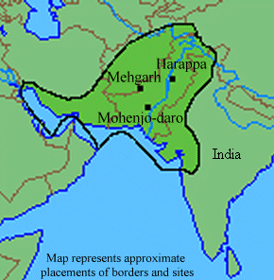
Indus Valley civilization

Slide 44
G:What modern day countries was the Indus Valley civ in?

Slide 45
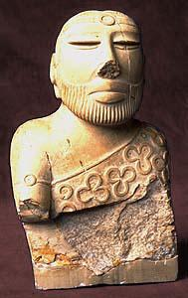
Indus River Valley
This civ is still mysterious.
The writing has not been translated.

Slide 46
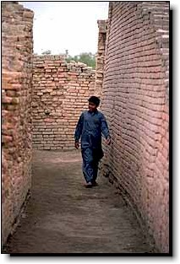
Indus River civilization
We do know the cities were sophisticated enough to have brick walls surrounding them for protection against flooding from the Indus River.

Slide 47
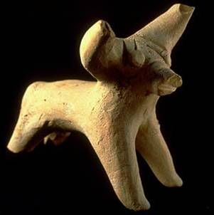
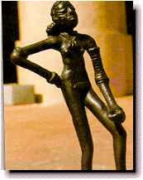
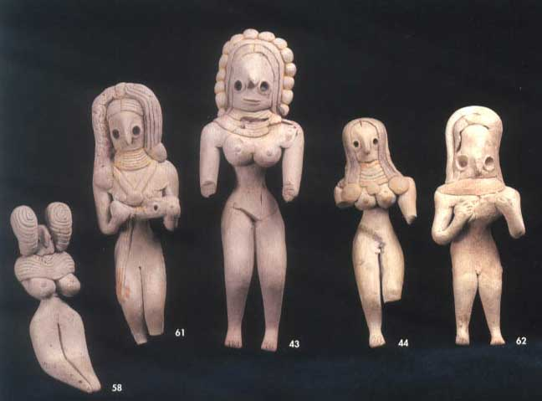
Various artifacts found

Slide 48
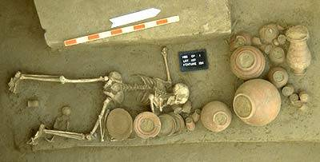



What are artifacts?

Slide 49

Indus Economy
Just like the other river valley civs, the Indus river valley people were mostly farmers.
Traditional economy
They did trade with Chinese and with Sumerians (Mesopotamians).

Slide 50
That concludes Indus River Valley Civilization.
Get ready for the quiz.

Slide 51
Indus River Quiz
P: Why do we know so little of the power structure in the Indus Valley?
E: How did the Indus make a living?
G:In what modern day country are the settlements of the Indus River Valley civilization?
G:Why did the cities have so many walls?
S: How do Indus artifacts demonstrate that the the the Indus Valley was sophisticated?

Slide 52

ANCIENT CHINA
Great Wall
Began 2000 B.C.
Mandate of
Heaven
Dynasties
Silk
astronomy

Slide 53

As in Egypt, Mesopotamia, and along the Indus River, Chinese civilization began within a major river valley. Modern China itself is a huge geographical expanse. Around 4000 BC, this huge area contained an almost infinite number of ethnic groups and languages. This history, in which a vast area populated by diverse ethnic groups became, over time, a more or less single culture, began in the Yellow River Valley.

Slide 54

Yellow River Civilization
G:Ancient China was formed around the Yellow River.
The color yellow symbolized “centrality”, as in China is the center of the world.

Slide 55

Chinese accomplishments
During the Zhou and Shang periods, the Chinese made remarkable achievements in astronomy and bronzework, learned to make silk and create books, and developed a complex system of writing

Slide 56

E:Chinese invented silk
Silk was exotic and expensive, so it was good for trading with the rest of the world.
It is made from silk worms.
Silk also makes “paper”

Slide 57

Silk worm

Slide 58
S:Chinese astronomy
  2137 BC - Chinese book 书经 records the earliest known solar eclipse on October 22.
  ca. 2000 BC - Chinese determine that Jupiter needs 12 years to complete one revolution of its orbit.
  ca. 1400 BC - Chinese record the regularity of solar and lunar eclipses and the earliest known solar variation日珥.
  ca. 1200 BC - Chinese divide the sky into twenty eight regions 二十八宿 for recognitions of the stars.
  ca. 1100 BC - Chinese first determine the spring equinox 黄赤交角.
  776 BC - Chinese make the earliest reliably record of solar eclipse.

Slide 59

In the Middle Ages the Arabs made known throughout Muslim Spain a material which was to replace all its predecessors. This was paper, whose manufacture they imported from far distant and mysterious realm of China.
The first paper appeared in China about 200 BC. Its name is derived from papyrus. Silk was transformed into paper by a process of pasting, but because silk was expensive, wool and cotton came to be used instead. This invention was attributed to Ts'ai Lun.
In the picture above, the manufacturing process used by the Chinese. They steeped mulberry or bamboo bark in water, then kneaded it to produce a paste from which they obtained smooth thin sheets of paper.

Slide 60
According to Chinese political theory, every dynasty goes through the so-called dynastic cycle:
  A new ruler unites China and founds a new dynasty.
  China, under the new dynasty, achieves prosperity and a new golden age.
  The royal family of the dynasty begins to decay, corruption becomes rampant in the imperial court, and the empire begins to enter decline and instability.
  The dynasty loses the Mandate of Heaven, their legitimacy to rule, and is overthrown by a rebellion. The Mandate of Heaven is then passed to the next dynasty

Slide 61


Slide 62



Ancient China

Slide 63


Chinese pyramids!!!!

Slide 64

The Great Wall of China was built to keep the Mongols out.

Slide 65

Many died building it, and their bodies were used as filler for it.

Slide 66
That concludes China.
Any questions before we take the quiz?

Slide 67
Ancient China Quiz
P: In China, according to the dynastic cycle, what happened to “bad kings”?
E: How did the Chinese earn a living?
G: What river was the earliest Chinese civilization centered around?
S: What technological advancements did the Chinese have?

Slide 68
This powerpoint was kindly donated to www.worldofteaching.com
http://www.worldofteaching.com is home to over a thousand powerpoints submitted by teachers. This is a completely free site and requires no registration. Please visit and I hope it will help in your teaching.

